Slide 1
9 A
WHAT I ATE YESTERDAY

Slide 2
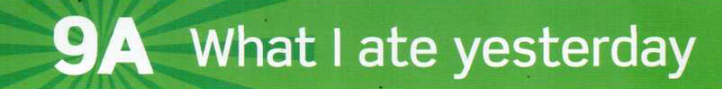

Slide 3
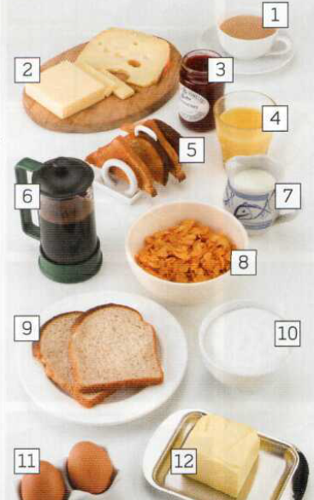
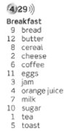

tea
cheese
jam
BREAKFAST
orange juice
toast
milk
coffee
COUNTABLE NOUNS
UNCOUNTABLE NOUNS
cereal
bread
sugar
A/AN
SOME/ANY+plural
ONE/TWO
A LOT OF
SOME/ANY+singular
A LOT OF
WHAT IS THERE ON THE TABLE?
?
butter
eggs

Slide 4
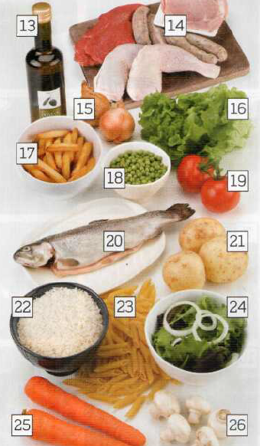
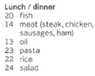
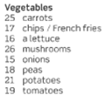
sausages
meat/ steak
LUNCH OR DINNER
Vegetables
oil
ham
chicken
pork
lettuce/ a lettuce
peas
chips
tomatoes
fish
potatoes
rice
salad
?
pasta
WHAT IS THERE ON THE TABLE?
carrots
mushrooms

Slide 5
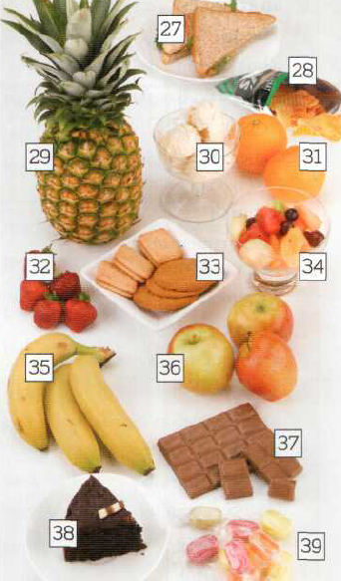
sandwiches
crisps
oranges
FRUIT, DESSERTS, AND SNACKS
a pineapple
ice cream
strawberries
fruit salad
bicuits
apples
bananas
chocolate
WHAT IS THERE ON THE TABLE?
?
cake/a piece of cake
sweets/candies

Slide 6
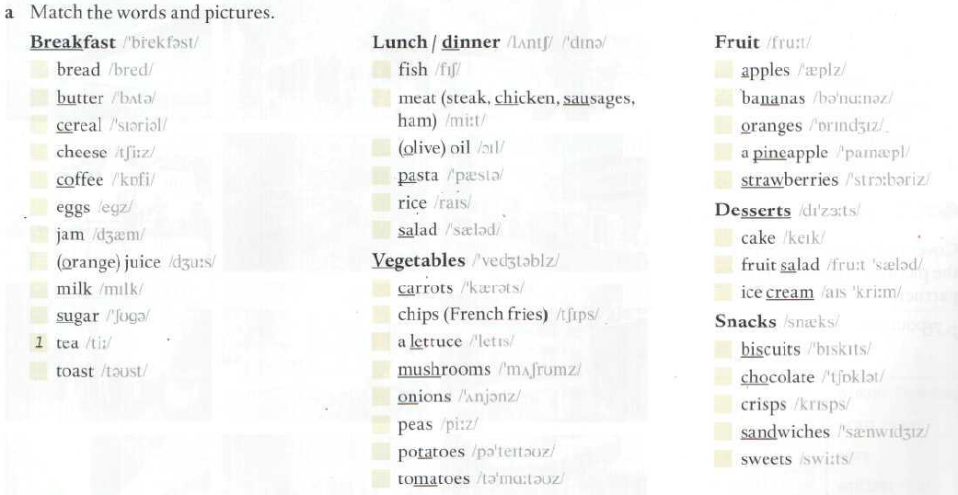
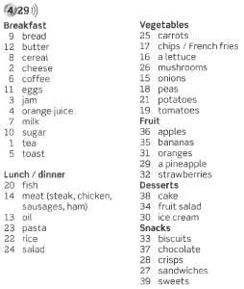
Do this exercise at page 163 Vocabulary Bank: Food

Slide 7
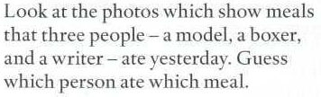
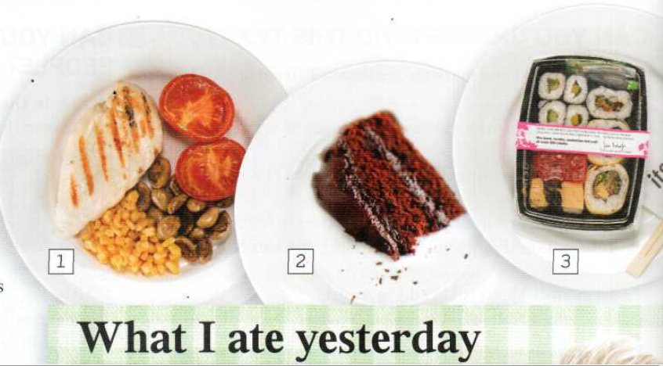
Page 68
tomatoes
some cake
A piece of chocolate cake
sushi
some chicken / a chicken breast
A grilled chicken breast
mushrooms
sweetcorn

Slide 8
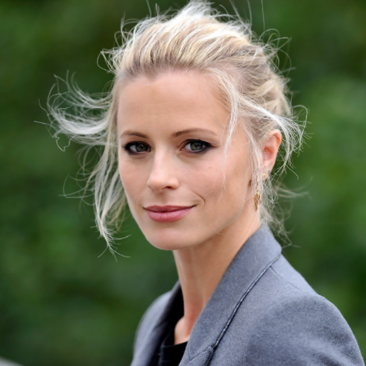
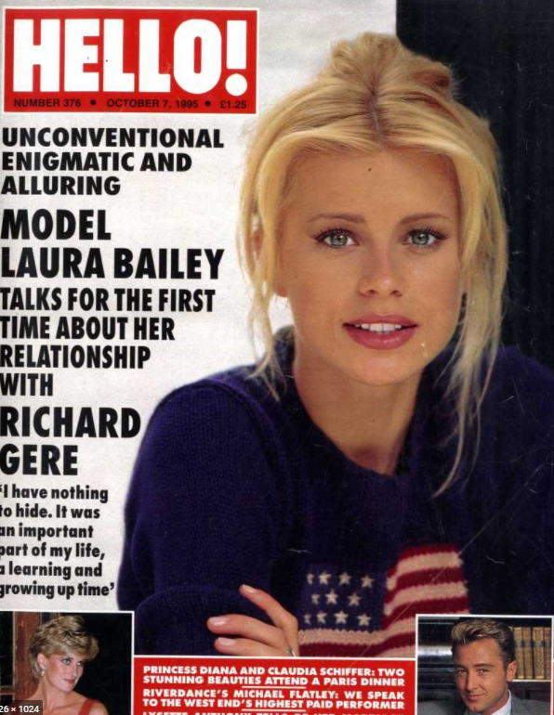
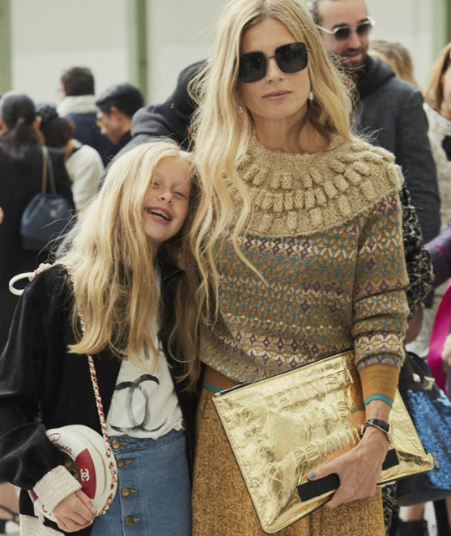

Slide 9
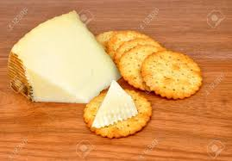
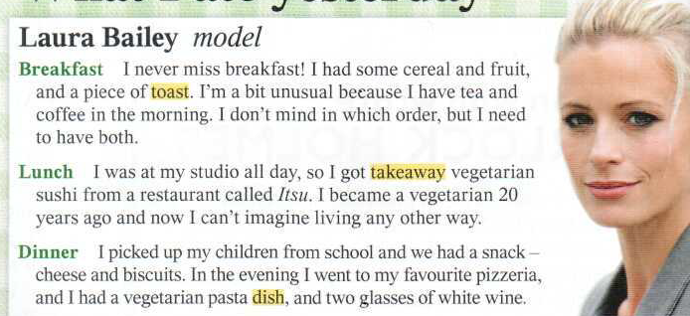
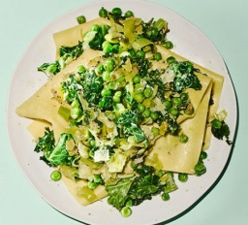
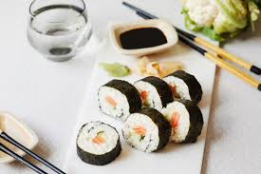
?
QUESTIONS ABOUT LAURA
1. What did she have for breakfast yesterday?
She had some cereal, some fruit, a piece of toast and tea and coffee for breakfast.
2. Why does she say that she is a bit unusual?
Because she always has tea and coffee in the morning (She doesn´t mind in which order)
3. What did she have for lunch?
4. What is sushi?
5. Is she a vegetarian?
6. When did she become a vegetarian?
7. Did she have lunch at home?
8. Did she have a snack in the afternoon?
9. What did she have for a snack?
10.What did she have for dinner?
11. Did she have dinner at home?
12. Did she drink wine?

Slide 10
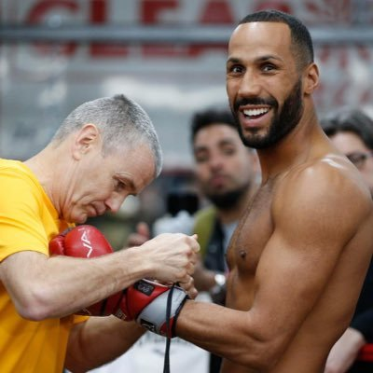
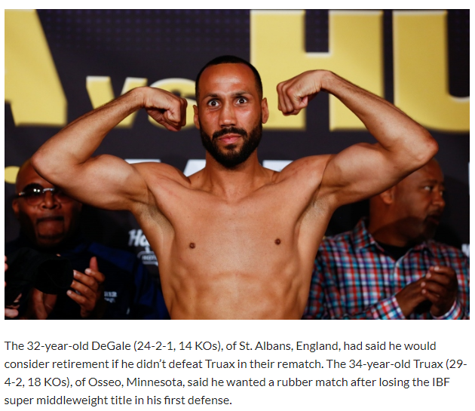

Slide 11
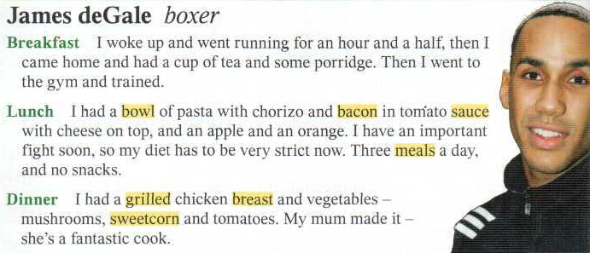
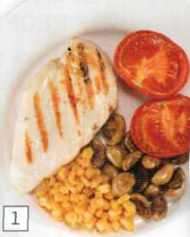
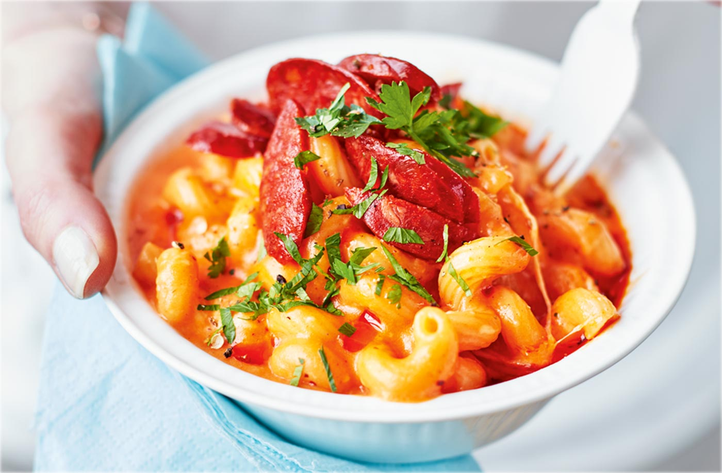
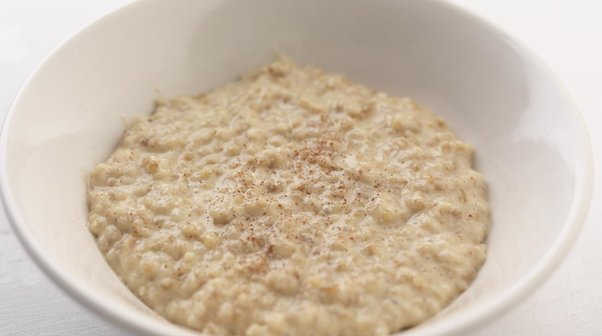
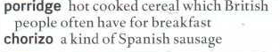
00.51
QUESTIONS ABOUT JAMES
1. What did he have for breakfast yesterday?
2. What is “porridge”? It is hot cooked cereal. Avena con leche.
3. What did he do after breakfast?
4. What did he have for lunch?
5. What did he have for dessert?
6. Is his diet strict?
7. Why ?
8. Did he have a snack?
9. How many meals does he have a day?
10. What did he have for dinner?
11. Who made dinner for him?
?

Slide 12
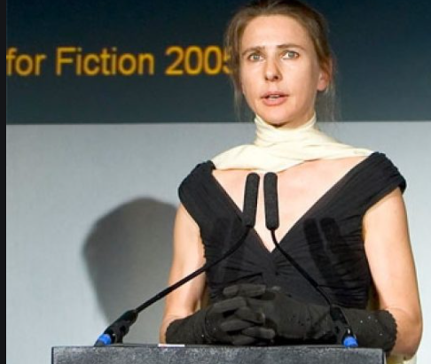


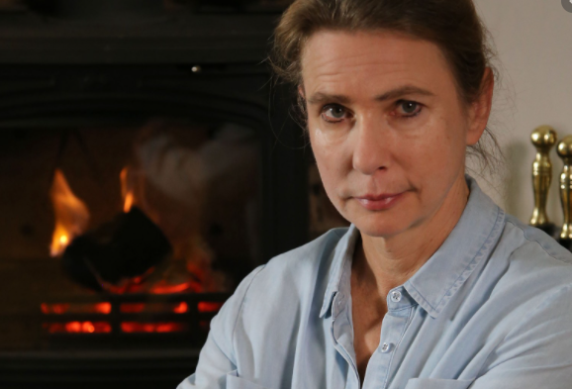

Slide 13
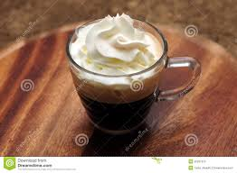
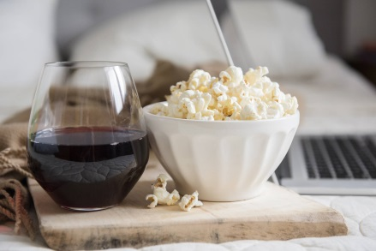
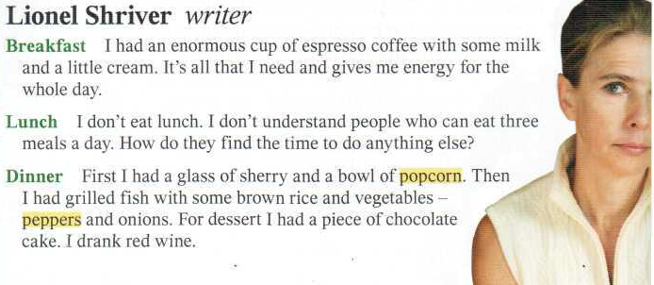
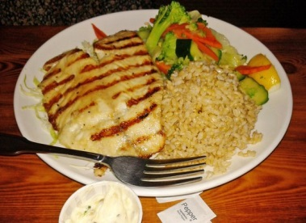
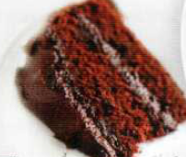
?
QUESTIONS ABOUT LIONEL
1. What did she have for breakfast yesterday ?
2. Did she have lunch?
3. Did she have a snack in the evening? What did she have?
4. What did she have for dinner?
5. What did she have for dessert?
6. Did she drink wine?
?
QUESTIONS ABOUT YOU
1.What did you have for lunch yesterday?
2. Did you have a snack?
3. What did you have for dinner ?.
4. Did you have breakfast this morning?
5. What did you have?

Slide 14
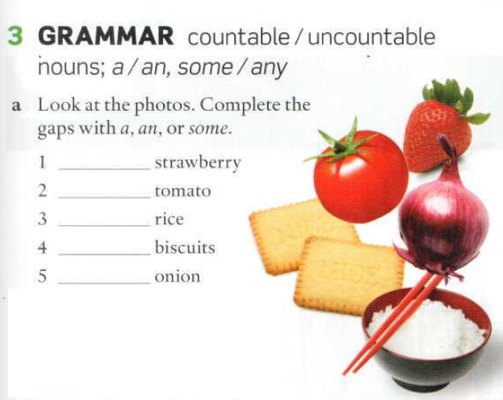
Page 69
a
a
some
some
an

Slide 15
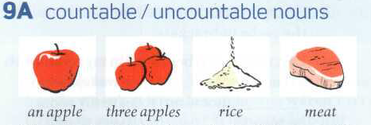
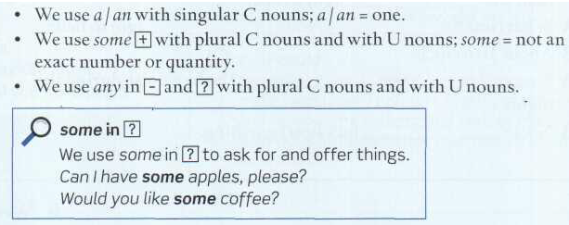
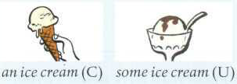
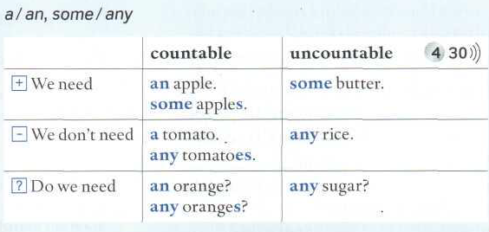
Page 140

Slide 16
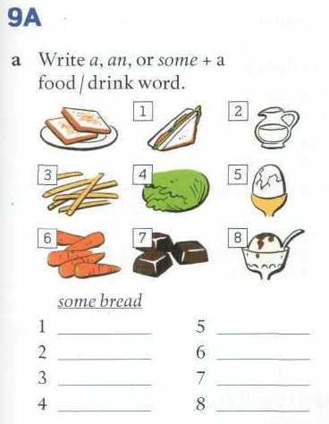
Page 141
an egg
A sandwich
some milk
some carrots
some chips/fries
some chocolates
some lettuce/ a lettuce
some ice cream

Slide 17
STARTERS
Memorize the dishes!
Which one do you prefer for a starter?
Sopa de zanahoria y naranja
Ensalada de zanahoria y cebolla

Slide 18
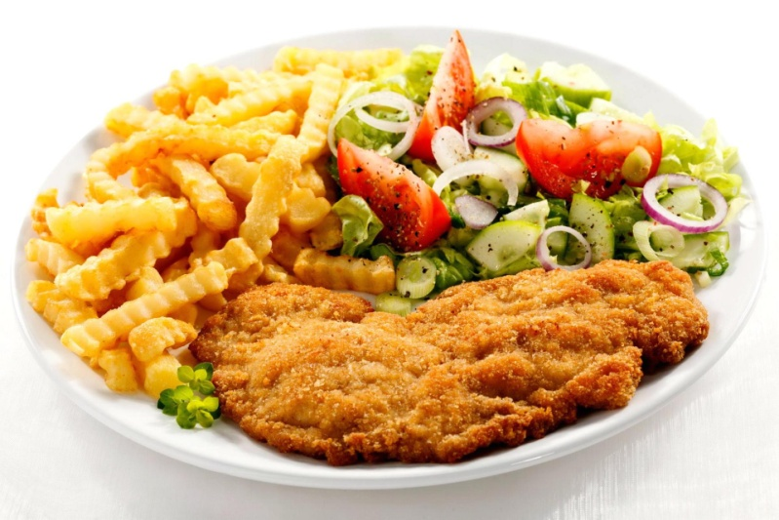
MAIN COURSES
Which one do you prefer for the main course?
Pechugas de pollo rellenas con queso crema
Pasta con salsa de pollo cremosa.
Breaded steak with pasta and tomato, broccoli and onion salad.
Milanesa con pastas y ensalada de tomate, brócoli y cebolla.

Slide 19
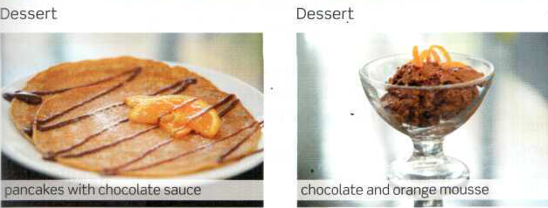
desserts
Which one do you prefer for dessert?
Panqueques con salsa de chocolate
Mousse de chocolate y naranja

Slide 20

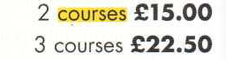
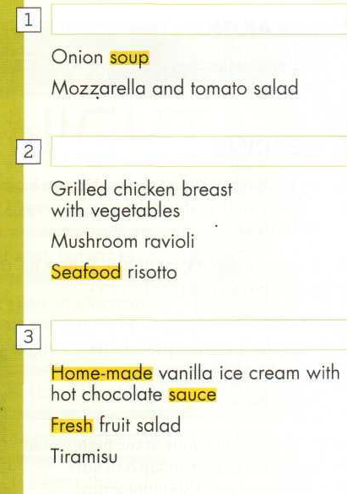
STARTERS
PAGE 74
Complete the menú.
Memorize the names of the dishes and answer the question.
What’s on the menú?
MAIN COURSES
DESSERTS

Slide 21


Slide 22
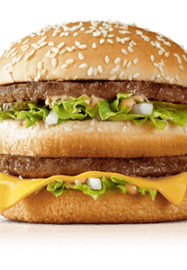
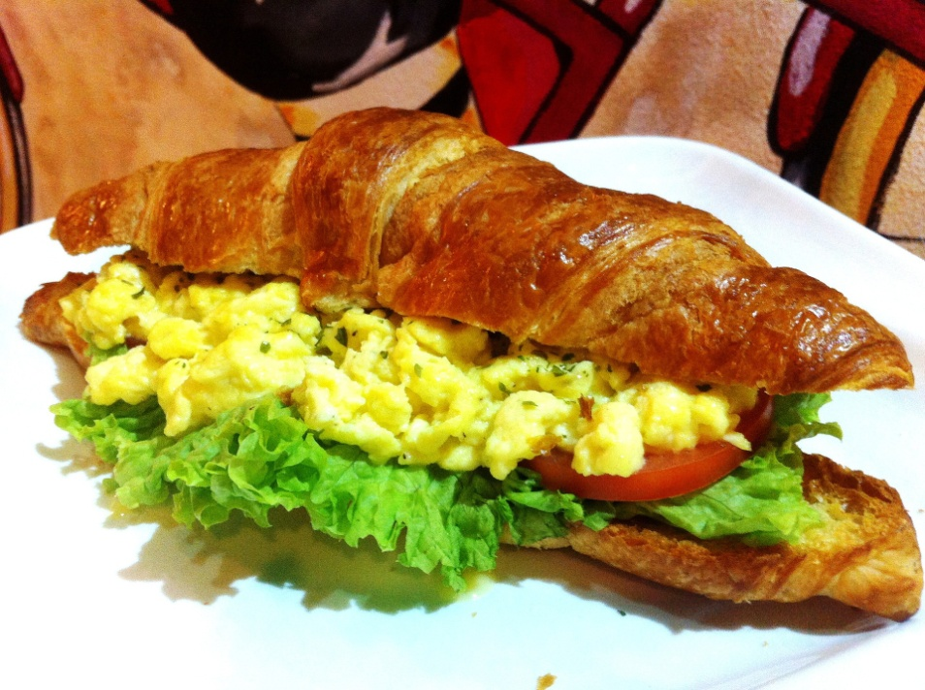
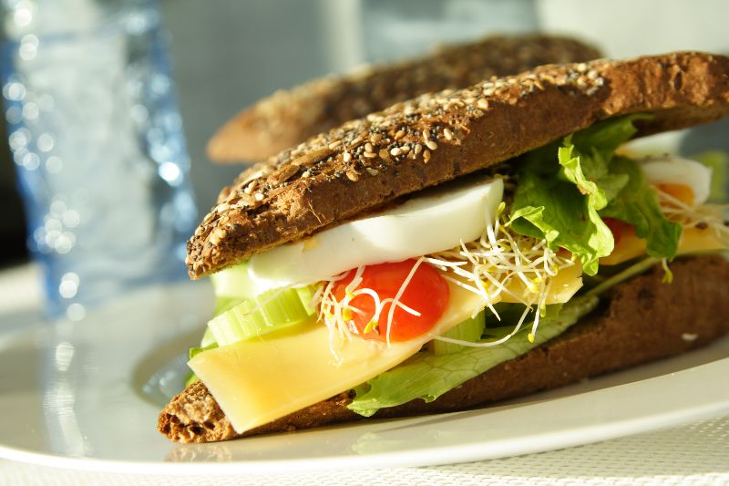
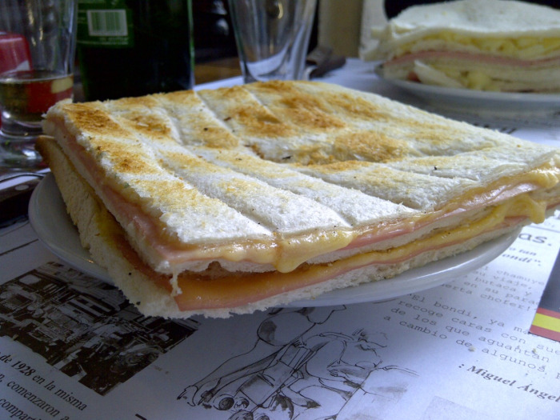
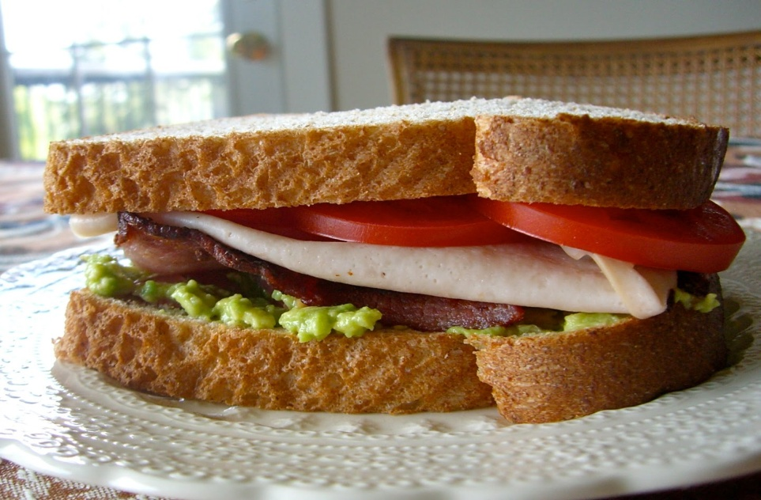
What is there in your favourite sandwich?
There is some bread, some ham, some cheddar cheese, two patties,
some lettuce, some mayonnaise,some ketchup…

Slide 23
What is there on the table?
There is some cheese,
There are some eggs,
You continue…

Slide 24
WHAT IS THERE ON THE TABLE?
There are some sandwiches,.
There is a pineapple
You continue…

